Slide 1
C#4.0 ファーストコンタクト
中博俊

Slide 2
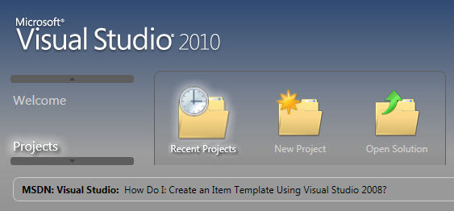
Visual Studio の変更
次期Visual Studio
Visual Studio 2010
  変更、修正箇所が半端無く多い
VSがWPFベースに
テスト支援がすごい
  再現情報の収集
  ビデオの収集

Slide 3
言語系
C# 4.0
VB 10.0
Python, Ruby DLR搭載?
F#搭載?
M搭載?
C++0x一部搭載（ちょっとしょぼめ）

Slide 4
C#4

Slide 5
C#4の新機能
Dynamic Types
  IronPython Script Support
Office Programmability
  Named Parameters
  No-PIA
Parallel Programming

Slide 6
dynamic
public class target {
public void Talk(){
Console.Write("wan");}}
static void Main(string[] args){
var x = CreateInstance();
x.Talk(); }
static object CreateInstance() {
return new target(); }

Slide 7
dynamic
var x = CreateInstance();
//x.Talk();
var type = x.GetType();
var mi = type.InvokeMember("Talk",
BindingFlags.Instance
| BindingFlags.InvokeMethod
| BindingFlags.Public,
null, x, null);

Slide 8
dynamic
dynamic x
=CreateInstance();
x.Talk();

Slide 9
dynamic
存在しないメソッドを呼んだ場合には？
RuntimeBinderException
at _stub_$1##1(Closure , CallSite , Object )
at System.Scripting.Actions.MatchCaller.CallVoid1[T0](Action`2 target, CallSite site, Object[] args)
at System.Scripting.Actions.CallSite`1.UpdateAndExecute(Object[] args)
at System.Scripting.Actions.UpdateDelegates.UpdateVoid1[T,T0](CallSite site, T0 arg0)

Slide 10
dynamic
Intにdynamicは？
static void M(object o){
dynamic i = (int)o; }
for ( var loop = 0 ; loop < i ; loop++ )
Error 1 Operator '<' cannot be applied to operands of type 'int' and '::dynamic'

Slide 11
Dynamic は Duck Typingにあらず
public class Dog { public void Talk() { Console.WriteLine("BowWow"); } }
public class Cat { public void Talk() { Console.WriteLine("Mew"); } }
public interface IAnimal { void Talk();}
static void Main(string[] args)
{
var d = new Dog();
var c = new Cat();
d.Talk();
c.Talk();
IAnimal a = d as IAnimal;
a.Talk();
}

Slide 12
Iron Python Support
using IronPython.Hosting;
using Microsoft.Scripting.Hosting;
ScriptRuntime py = Python.CreateRuntime();
dynamic random = py.UseFile("random.py");
random.shuffle(items);

Slide 13
Office Develop & Named Parameters
ord.Selection.PasteSpecial(
Link: true,
DisplayAsIcon: true);

Slide 14
Task
using System.Threading;
using System.Threading.Tasks;
static void M(object o)
{
int i = (int)o;
for ( var loop = 0 ; loop < i ; loop++ )
Console.WriteLine(
string.Format("{0}:{1}", o, loop ));
}

Slide 15
Task
class Program {
static void Main(string[] args) {
var tm = TaskManager.Default;
if (Environment.ProcessorCount < 4) {
tm = new TaskManager(new TaskManagerPolicy(1, 4, 4)); }
var lt = new List<Task>();
for (var i = 0; i < 10; i++) {
Task t = Task.StartNew(M, i, tm);
lt.Add(t);}
Task.WaitAll(lt.ToArray());
}

Slide 16
Parallel.For
Parallel.For (1, 30,
i => { M(i); });
でもVirtualMachine上ではパラレルで動かない

Slide 17
Parallel.For
Parallel.For<int>(1, 30, 1,
() => 1,
(i, s) => M(i),
(i) => { },
new TaskManager(
new TaskManagerPolicy(1, 4, 4)), TaskCreationOptions.SelfReplicating);

Slide 18
Parallel LINQ (PLINQ)
(from x in Enumerable
.Range(1,30).AsParallel(4)
where x % 2 == 0
select x)
.ForAll(i =>
Console.WriteLine(i));

Slide 19
キーとなるクラスとデリゲート
public delegate void Action2(object obj)
public delegate void Action2<T1,T2>(T1 obj1, T2 obj2)
public delegate void Action2<T1,T2,T3>(T1 obj1, T2 obj2, T3 obj3)
public delegate T Func2<T>()
public delegate TResult Func2<T,TResult>(T val)
Task
TaskManager
ParallelEnumerable

Slide 20
C#4 まとめ
Parallel
プログラミングが
アツイ！

